Slide 1
Disk Drives
Tom Rethard
Disk Photographs courtesy of
www.howstuffworks.com

Slide 2
Disk vs. Tape
Disk
magnetic recording material is layered onto a high-precision aluminum or glass disk.
can move to any point on the surface of the disk almost instantly.
read/write head "flies" over the disk, never actually touching it.
platter can spin underneath its head at speeds up to 3,000 inches per second (about 170 mph or 272 kph)!
information stored in extremely small magnetic domains compared to a cassette tape's. The size of these domains is made possible by the precision of the platter and the speed of the medium.
Tape
magnetic recording material on a cassette tape is coated onto a thin plastic strip
fast-forward or reverse to get to any particular point on the tape
read/write head touches the tape directly
tape in a cassette-tape deck moves over the head at about 2 inches (about 5.08 cm) per second

Slide 3
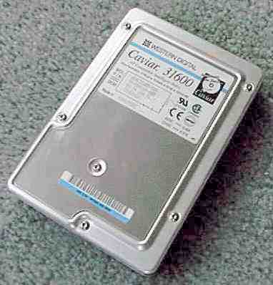
Typical 3.5” Hard Drive

Slide 4
Warning
Do Not Try This At Home

Slide 5
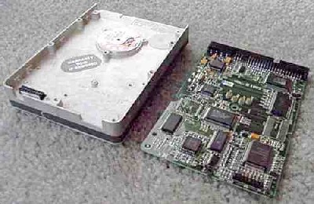
Controller Board

Slide 6
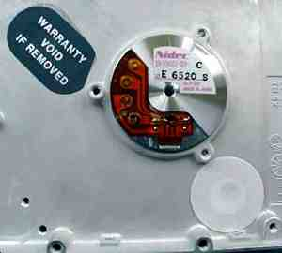
Drive Motor

Slide 7
Moving the Heads
Two principle techniques
Voice Coil
  Like a speaker cone
  Moves straight in and straight out
Stepper Motor
  Usually winds a flexible metal band around the shaft
  Band lies across an arc on one end of the actuator
  Moving the band translates into moving the heads in and out

Slide 8
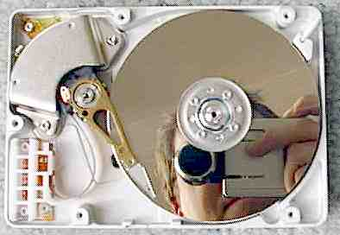
Gone Topless.....
Platters
Stepper Motor (Hidden)
Actuator Arm
Notes:
The platters, which typically spin at 3,600 or 7,200 rpm when the drive is operating. These platters are manufactured to amazing tolerances and are mirror-smooth (as you can see in this interesting self-portrait of the author... no easy way to avoid that!).
The arm that holds the read/write heads is controlled by the mechanism in the upper-left corner, and is able to move the heads from the hub to the edge of the drive. The arm and its movement mechanism are extremely light and fast. The arm on a typical hard-disk drive can move from hub to edge and back up to 50 times per second -- it is an amazing thing to watch!

Slide 9
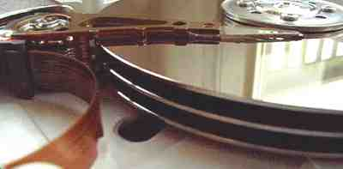
Platters and Heads
Head

Slide 10
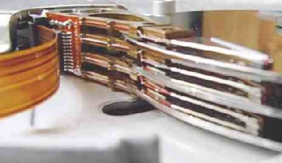
Heads
Heads
Actuator
Flex Circuit Connected to Heads

Slide 11
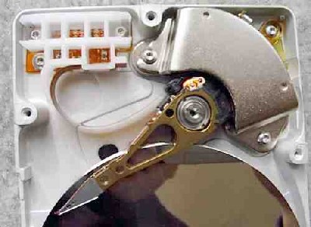
The Actuator
Stepper Motor (Hidden)

Slide 12
Formatting
Provides a structure into which to record data
Low-Level Format
  Establishes tracks and sectors
  May change the interleave of sectors
High-Level Format
  File subsystem dependent
  Writes structures requires by the file subsystem
    FAT
    Boot sector

Slide 13
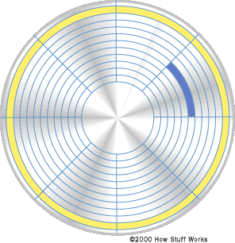
Tracks and Sectors

Slide 14
NOTE!
Not all disk drives use sectors as do PC drives
Some mainframe drives use variations known as
  CKD – Count Key Data
  CD – Count Data
in which performance is enhanced by allowing more complex operations.

Slide 15
Drive Speed Measurement
Data rate - The number of bytes per second that the drive can deliver to the CPU. Rates between 5 and 40 megabytes (or higher now) per second are common.
Seek time - The time required to move the head from one track to another. Times between 5 and 20 milliseconds are common.
Rotational Delay (Latency) – The time required for the required data to be moved under the head of the disk once the head is on the correct track. (Mean is ½ rotation time)
  Latency can be minimized through the use of a Track-Level Buffer, which allows the current track to be held in memory at all times. Newer drives extend this concept to a more generalized buffer.

Slide 16
Drive Response Time

Slide 17
The IDE Port
IDE Controller is on the disk drive
  If two drives, then one is master, one slave
  IDE = Integrated Drive Electronics
  Also known as ATA (AT Attachment)

Slide 18
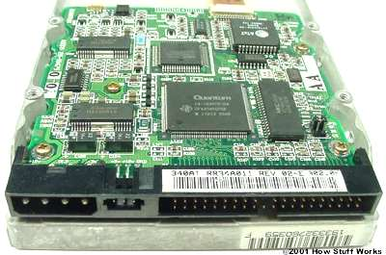
IDE Controller

Slide 19
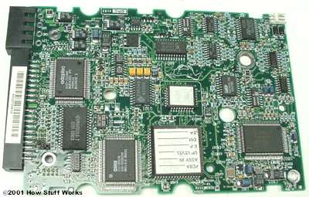
Another View

Slide 20
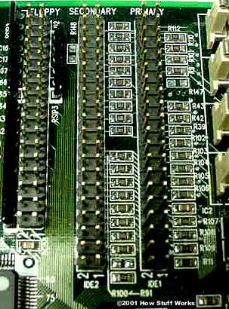
Host End
Usually supplies two IDE connections

Slide 21
IDE Standards
ATA-1
  original specification for Compaq Deskpro 386.
  instituted the use of a master/slave configuration
  based on a subset of the standard ISA 96-pin connector that uses either 40 or 44 pin connectors and cables
  44-pin version, the extra four pins are used to supply power to a drive that doesn't have a separate power connector (rare)
  provides signal timing for direct memory access (DMA) and programmed input/output (PIO) functions
    DMA means that the drive sends information directly to memory
    PIO means that the CPU manages the information transfer
  ATA-1 is more commonly known as IDE

Slide 22
ATA Standards
ATA-2
  DMA was fully implemented
  DMA transfer rates increased from 4.16 megabytes per second (MBps) in ATA-1 to as many as 16.67 MBps
  provides power management, PCMCIA card support and removable device support
  often called EIDE (Enhanced IDE), Fast ATA or Fast ATA-2
  total hard drive size supported increased to 137.4 gigabytes
  provided standard translation methods for Cylinder Head Sector (CHS) for hard drives up to 8.4 gigabytes in size

Slide 23
ATA Standards
ATA-3
  addition of Self-Monitoring Analysis and Reporting Technology (SMART)
  adds password protection to access drives

Slide 24
ATA Standards
ATA-4
  Ultra DMA support
    increased the DMA transfer rate from ATA-2's 16.67 MBps to 33.33 MBps.
  AT Attachment Program Interface (ATAPI) standard
    ATAPI provides a common interface for CD-ROM drives, tape backup drives and other removable storage devices.
    Before ATA-4, ATAPI was a completely separate standard.
  introduced a cable that has 80 conductors.
    The extra 40 conductors are ground wires interspersed between the standard 40 conductors to improve signal quality.
  known as Ultra DMA, Ultra ATA and Ultra ATA/33.

Slide 25
ATA Standards
ATA-5
  The major update auto detection of which cable is used: the 40-conductor or 80-conductor version.
  Ultra DMA is increased to 66.67 MB/sec with the use of the 80-conductor cable.
  also called Ultra ATA/66.

Slide 26
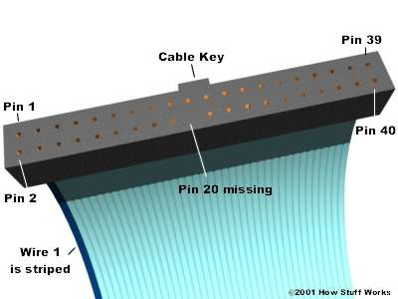
The Cable

Slide 27
Pin | Description | Pin | Description
1 | Reset | 23 | -IOW
2 | Ground | 24 | Ground
3 | Data Bit 7 | 25 | -IOR
4 | Data Bit 8 | 26 | Ground
5 | Data Bit 6 | 27 | I/O Channel Ready
6 | Data Bit 9 | 28 | SPSYNC: Cable Select
7 | Data Bit 5 | 29 | -DACK 3
8 | Data Bit 10 | 30 | Ground
9 | Data Bit 4 | 31 | RQ 14
10 | Data Bit 11 | 32 | -IOCS 16
11 | Data Bit 3 | 33 | Address Bit 1
12 | Data Bit 12 | 34 | -PDIAG
13 | Data Bit 2 | 35 | Address Bit 0
14 | Data Bit 13 | 36 | Address Bit 2
15 | Data Bit 1 | 37 | -CS1FX
16 | Data Bit 14 | 38 | -CS3FX
17 | Data Bit 0 | 39 | -DA/SP
18 | Data Bit 15 | 40 | Ground
19 | Ground | 41 | +5 Volts (Logic) (Optional)
20 | Cable Key (pin missing) | 42 | +5 Volts (Motor) (Optional)
21 | DRQ 3 | 43 | Ground (Optional)
22 | Ground | 44 | -Type (Optional)

Slide 28
Master-Slave
A single IDE interface can support two devices.
Most motherboards come with dual IDE interfaces (primary and secondary) for up to four IDE devices.
To allow for two drives on one cable, IDE uses master and slave. This allows one drive's controller to tell the other drive when it can transfer data.
  slave drive makes a request to the master drive
  If the master drive is idle, it tells the slave drive to go ahead.
  If the master drive is communicating with the computer, it tells the slave drive to wait and then informs it when it can go ahead.
  The computer determines if there is a second (slave) drive attached through the use of Pin 39 on the connector. Pin 39 carries a special signal, called Drive Active/Slave Present (DASP), that checks to see if a slave drive is present.
Cable Select (CS).
  With the correct type of cable, can be auto configured as master or slave.
  A jumper on each drive is set to the CS option.
  The cable itself is normal except Pin 28 only connects to the master drive connector.
  On power up, the IDE interface sends a signal on Pin 28.
  Drive attached to the master connector receives the signal and configures itself as the master drive.
  Since the other drive received no signal, it defaults to slave mode.

Slide 29
Programming
Use the interface in your favorite language.
Trust me – the ATA-5 spec is nearly 300 pages long, and you’ll need it to program at the lowest level!

Slide 30
“Serial ATA”
Old ATA (“AT Attachment”)
  From 3 Mbytes/second since in the 1980s to a burst data transfer rate of 133 Mbytes/second
  Showing its age
    5-volt signaling requirement
    high pin count
    serious cabling headaches.
Serial ATA (“Advanced Technology Architecture”)
  to replace parallel ATA with the compatibility with existing operating systems and drivers
  adding performance headroom for years to come.
  reduces voltage and pin count requirements
  can be implemented with thin and easy to route cables
  faster transfer rate of 150 Mbytes/sec, to be doubled in the next generation

Slide 31
Serial ATA
 | Parallel ATA | Serial ATA
Bandwidth | 100/133 MB/Secs | 150/300/600 MB/Secs
Volts | 5V | 250mV
Pins | 40 | 7
Length Limitation | 18 inch (45.72cm) | 1 meter (100cm)
Cable | Wide | Thin
Ventilation | Bad | Good
Peer-to-Peer | No | Yes

Slide 32

Serial ATA Cable Comparison
IDE Cable
Serial ATA Cable

Slide 33
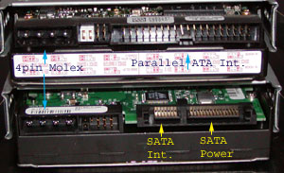
Drive Comparison

